Slide 1
Team Hortons
Live subtitles headset

Slide 2
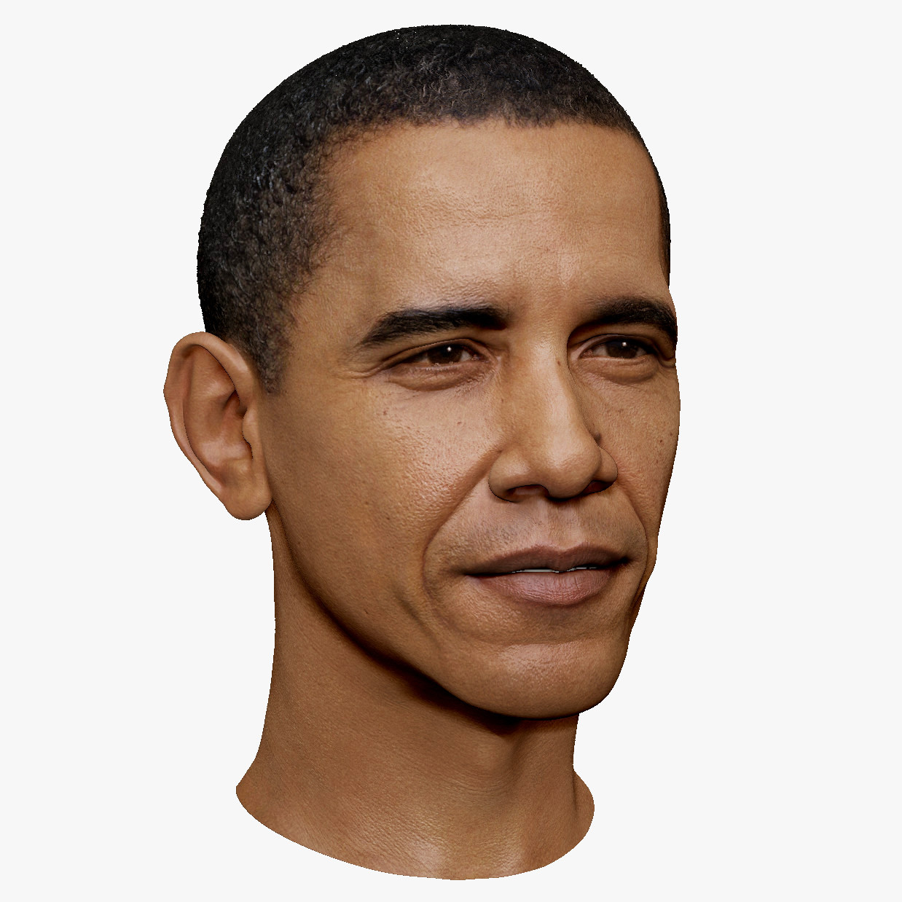
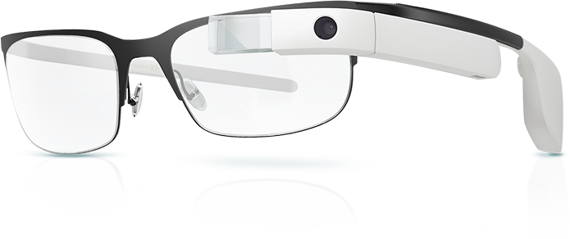
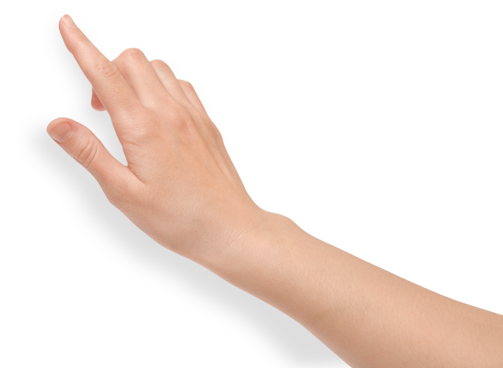
Put on the glasses. For the purposes of the prototype demonstration, click.

Slide 3
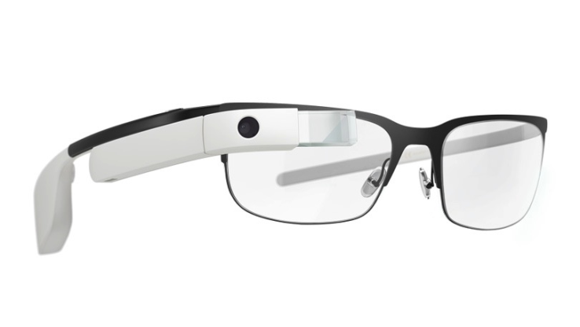
Press the red, circle button to turn on the glasses.

Slide 4


Calibrating Microphone...

Slide 5

Sync for additional features.
Device is ready! Hold the blue button to begin.

Slide 6
Device is synced!
Hold the blue button to begin.

Slide 8
Hold the blue, square button to turn on the direction indicators.

Slide 9
Calibrating Direction Sensors...

Slide 10
Direction Sensors On!

Slide 12
Your device is all set. John starts talking on your right. (Click to move on and face John)

Slide 13
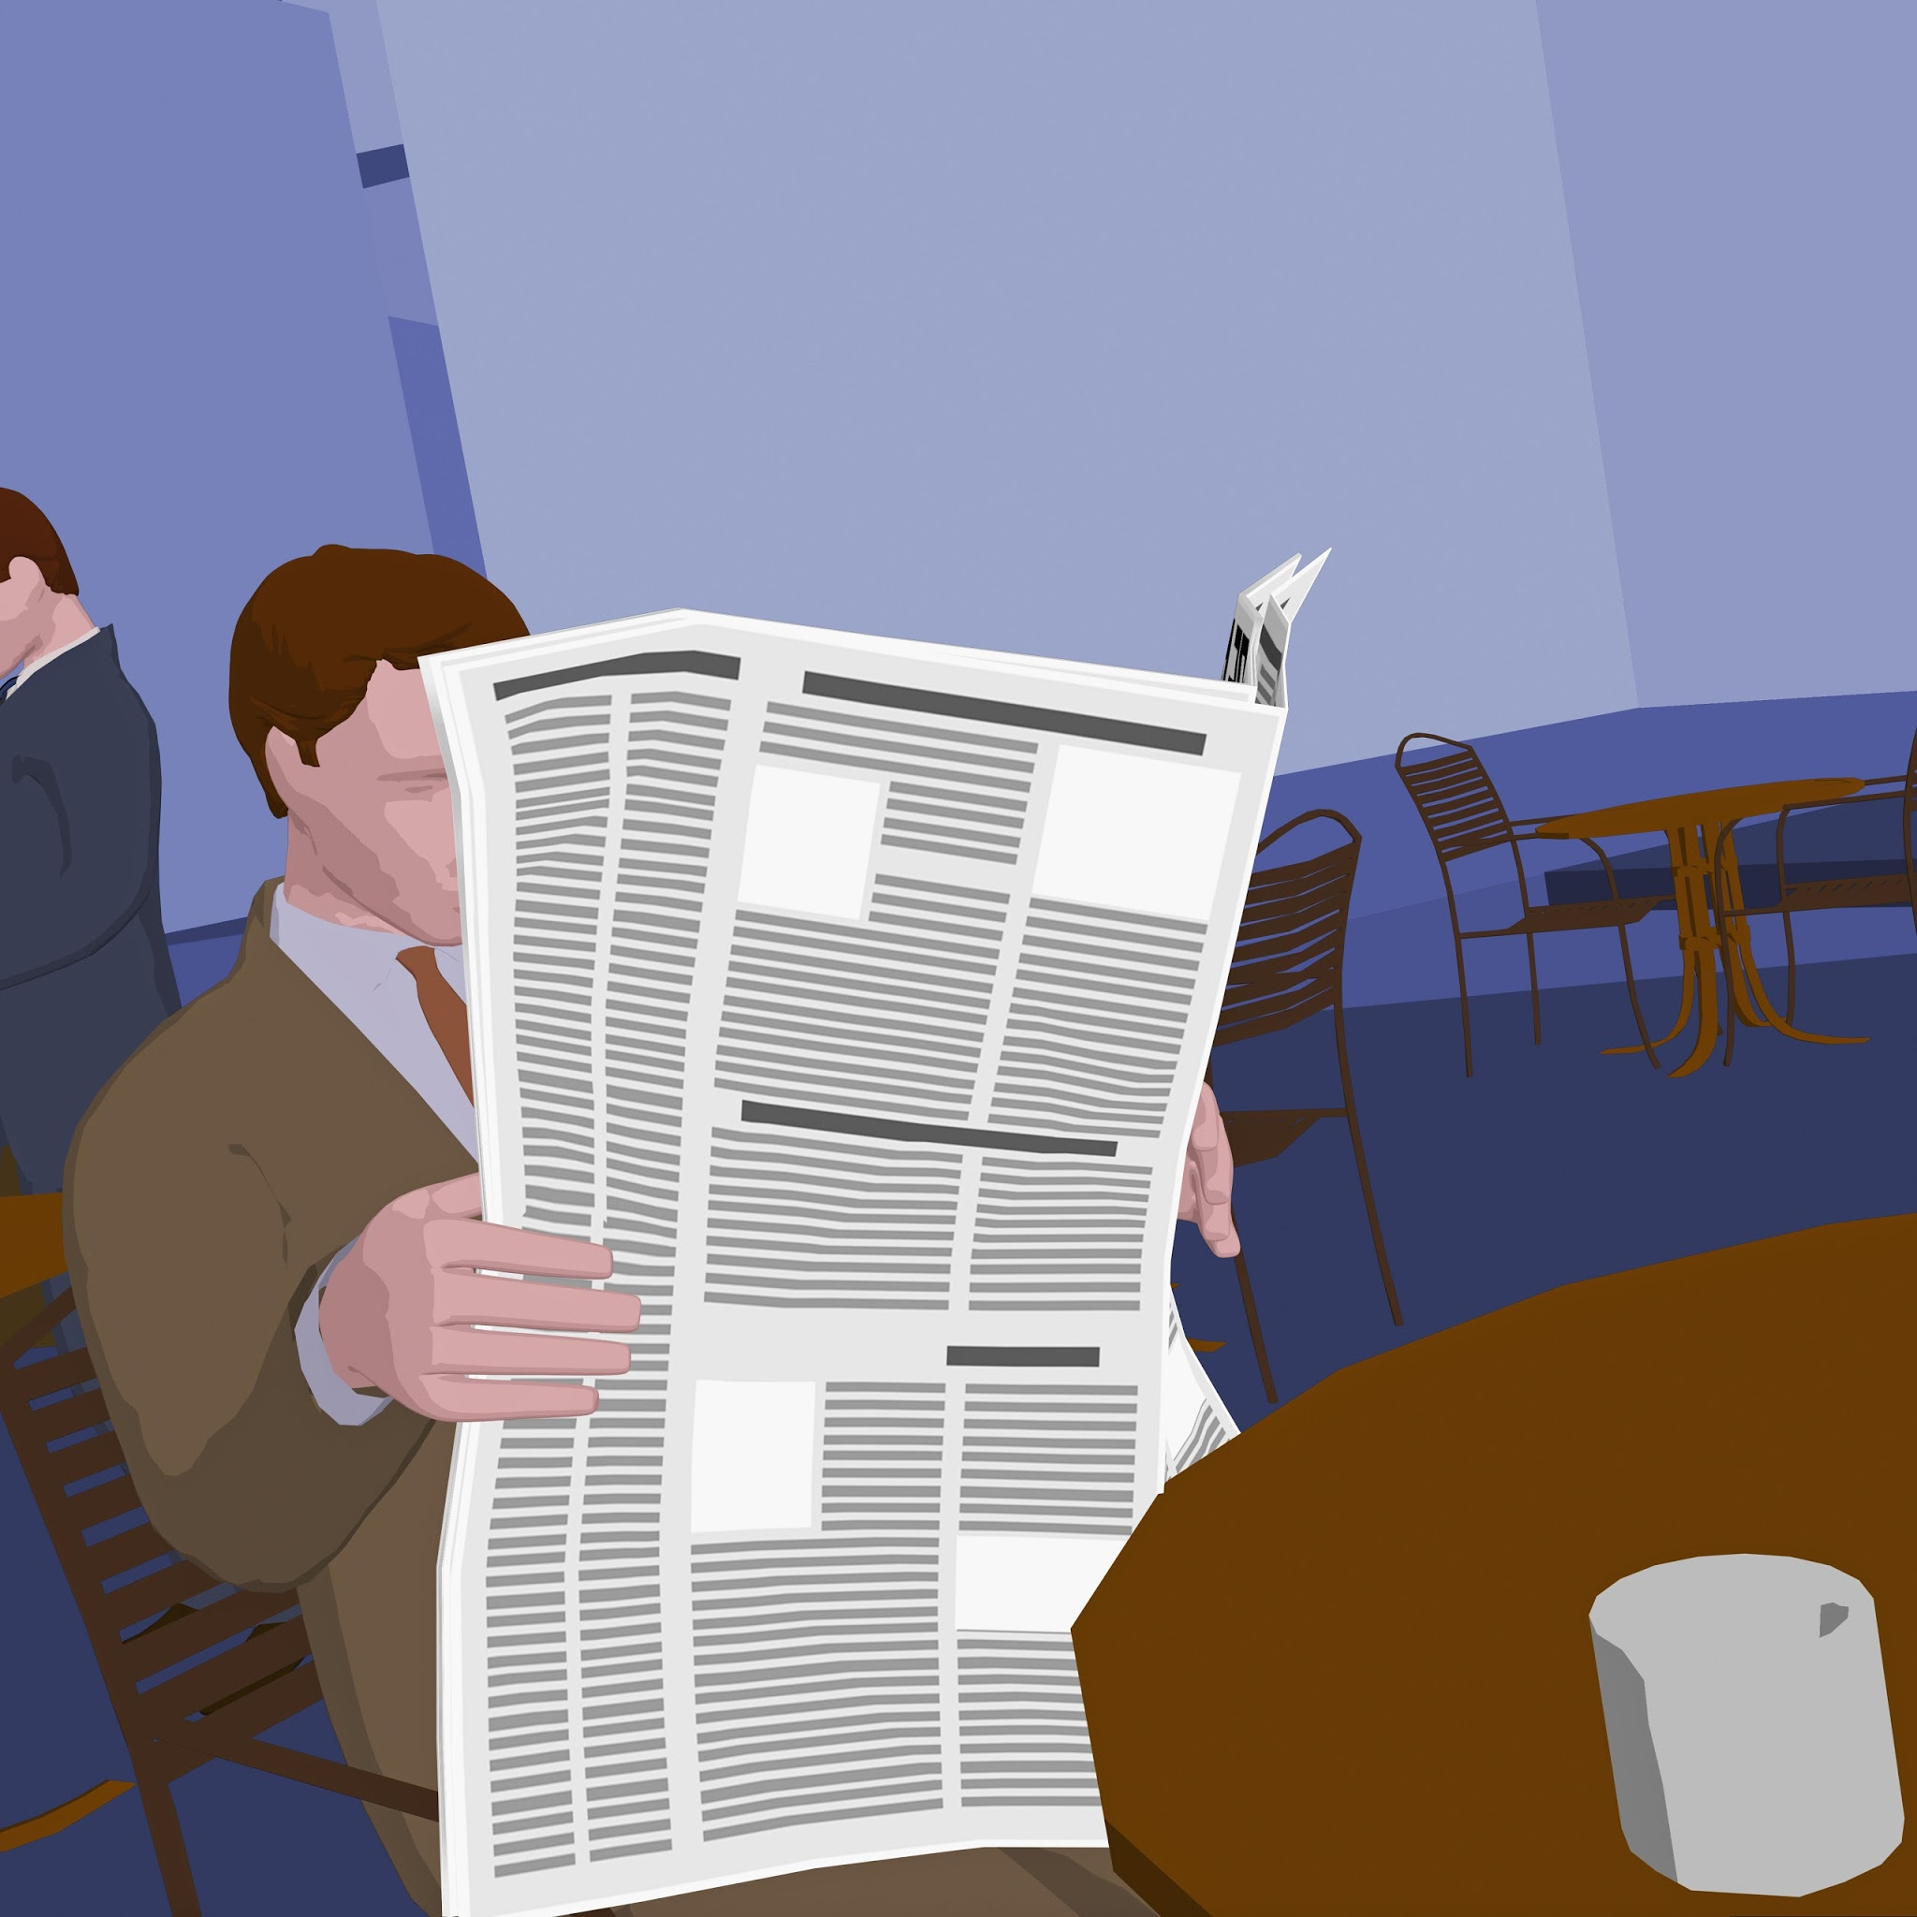

Slide 14
This person is talking. Follow conversation?

Slide 15
To follow the conversation, hold the grey button on the top until a notification appears on screen.
To ignore the conversation, tap the grey button.
Tap
Hold
For prototype demonstration purposes, click the relevant action above the button.

Slide 16

Following!

Slide 17
In this newspaper, but I think
that the relevant point of the
article for our business is that

Slide 19
You have powered off the device.

Slide 20
You have turned off the direction sensors.

Slide 21
Hitting this button has no effect without a conversation prompt.

